Slide 1
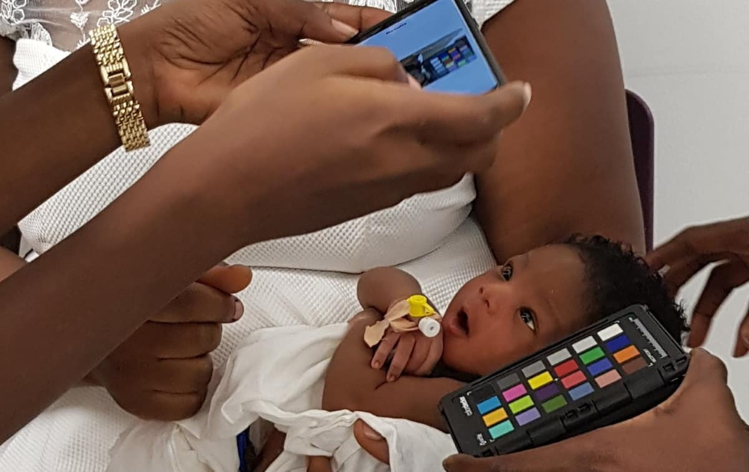
[1]

Slide 2

UNIVERSITY OF GHANA
DEPARTMENT OF COMPUTER ENGINEERING
Development of Smartphone App for Jaundice Detection in Newborns Using Artificial Intelligence
BY
1.KELVIN PRINCE BOATENG - 10893090
2.FIAGBENYA EDUDZI MACKBETH - 10869594
SUPERVISOR
DR.MARGARET RICHARDSON

Slide 3
CONTENTS
Introduction
Problem Statement
Relevance of project
Project Objective
Literature Review
Methodology
Resource
Budget
Task Schedule
Roles & Responsibilities
Conclusion
References

Slide 4
INTRODUCTION
This project is motivated by the need to improve infant healthcare through accessible and noninvasive jaundice detection.
Jaundice results from excess bilirubin in the blood, causing skin, eyes, and mucus membrane to turn yellow.
Jaundice in infants can cause mild symptoms such as sleepiness and poor feeding, but in severe cases it can lead to brain damage (cerebral palsy), hearing loss, vision problems and other long-term health disabilities.

Slide 5
A 2019 study in Pediatrics revealed that approximately [1]26.2 million children worldwide develop jaundice each year.
Africa accounts for 60% of these cases, with 15.7 million children affected annually.
In Ghana alone, 100,000 children contract jaundice each year, constituting about 1% of all neonatal deaths in the country. [2]The Child Health Outpatient Department of the Korle-Bu Teaching Hospital in Ghana records daily cases of neonatal jaundice.
The goal is to develop a cost-effective and user-friendly solution for jaundice detection by utilizing smartphones. This approach enable guardians to screen newborns for jaundice using the device's camera through artificial intelligence and machine learning.

Slide 6
PROBLEM STATEMENT
Neonatal jaundice remains a significant health concern globally, affecting a considerable number of newborns in their first week of life.
Timely and accurate detection of jaundice is crucial to prevent potential complications, such as kernicterus, which can lead to long-term neurological damage.

Slide 7
PROBLEM STATEMENT
Traditional methods of jaundice detection involve visual assessment and blood tests, often leading to delayed diagnosis and increased healthcare burdens.
In light of these challenges, there is a critical need for an efficient, non-invasive, and user-friendly solution to enable early detection of jaundice in newborns.

Slide 8
RELEVANCE OF WORK
Early Detection and Intervention
Non-Invasive and Convenient Testing
Improved Accessibility in Resource-Limited Settings
Affordability

Slide 9
OBJECTIVES
To develop an accurate and user-friendly smartphone app that can effectively detect jaundice in neonates.
To design a user interface that is easy to navigate for parents and healthcare providers.
To develop a machine learning algorithm that can accurately estimate bilirubin levels in newborns based on images of their skin or eyes.
To make the app accessible.

Slide 10
LITERATURE REVIEW
Author | Title | Focus | Limitation
Srujana Swarna , Sekar Pasupathy et al [3] | The smart phone study: assessing the reliability and accuracy of neonatal jaundice measurement using smart phone application | Reliability and accuracy of neonatal jaundice measurement using a smart phone application | Targeted fewer communities and also need a color calibration card
Pouria Padidar, Mohammadamin Shaker et al [4] | Detection of Neonatal Jaundice by Using an Android OS-Based Smartphone Application | Present a new method for detecting neonatal jaundice using an Android OS-based smartphone application. | Targeted 113 neonates
Dr. Alhanoof Althnian,Nada Almanea et al [5] | Neonatal Jaundice Diagnosis Using a Smartphone Camera Based on Eye, Skin, and Fused Features with Transfer Learning | Diagnosing neonatal jaundice that is non-invasive and convenient for both healthcare providers and parents. | Targeted 3 features which makes data cumbersome to collect

Slide 11
PROPOSED SOLUTION
Develop a user-Friendly Interface for both health professionals and care givers.
Integrate a system that allows care givers to reach out to professionals
Development of algorithms trained on a diverse dataset of newborns

Slide 12
METHODOLOGY
Literature Review & Data Collection
Model Development & Training
App Development
Testing
Deployment

Slide 13
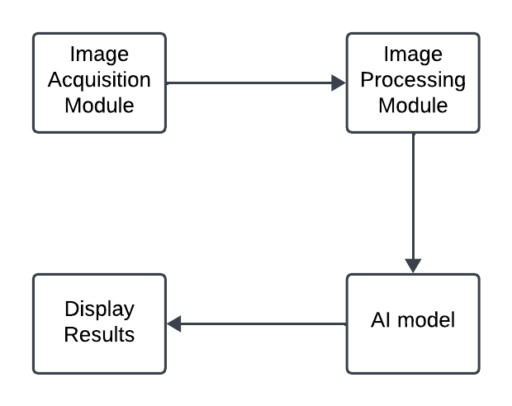
ARCHITECTURAL VIEW

Slide 14
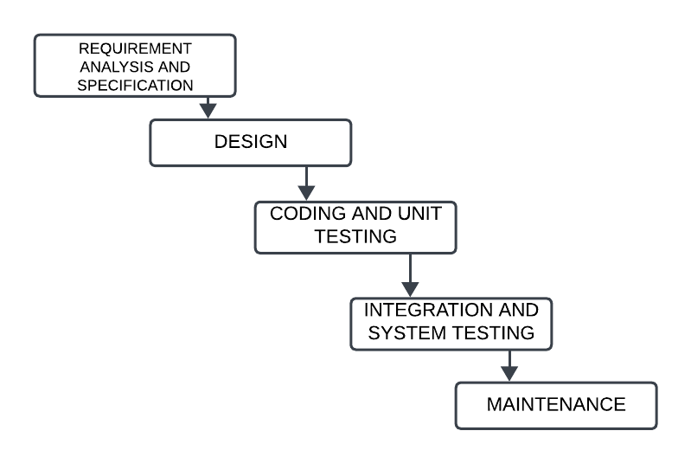
SOFTWARE DEVELOPMENT LIFE CYCLE

Slide 15
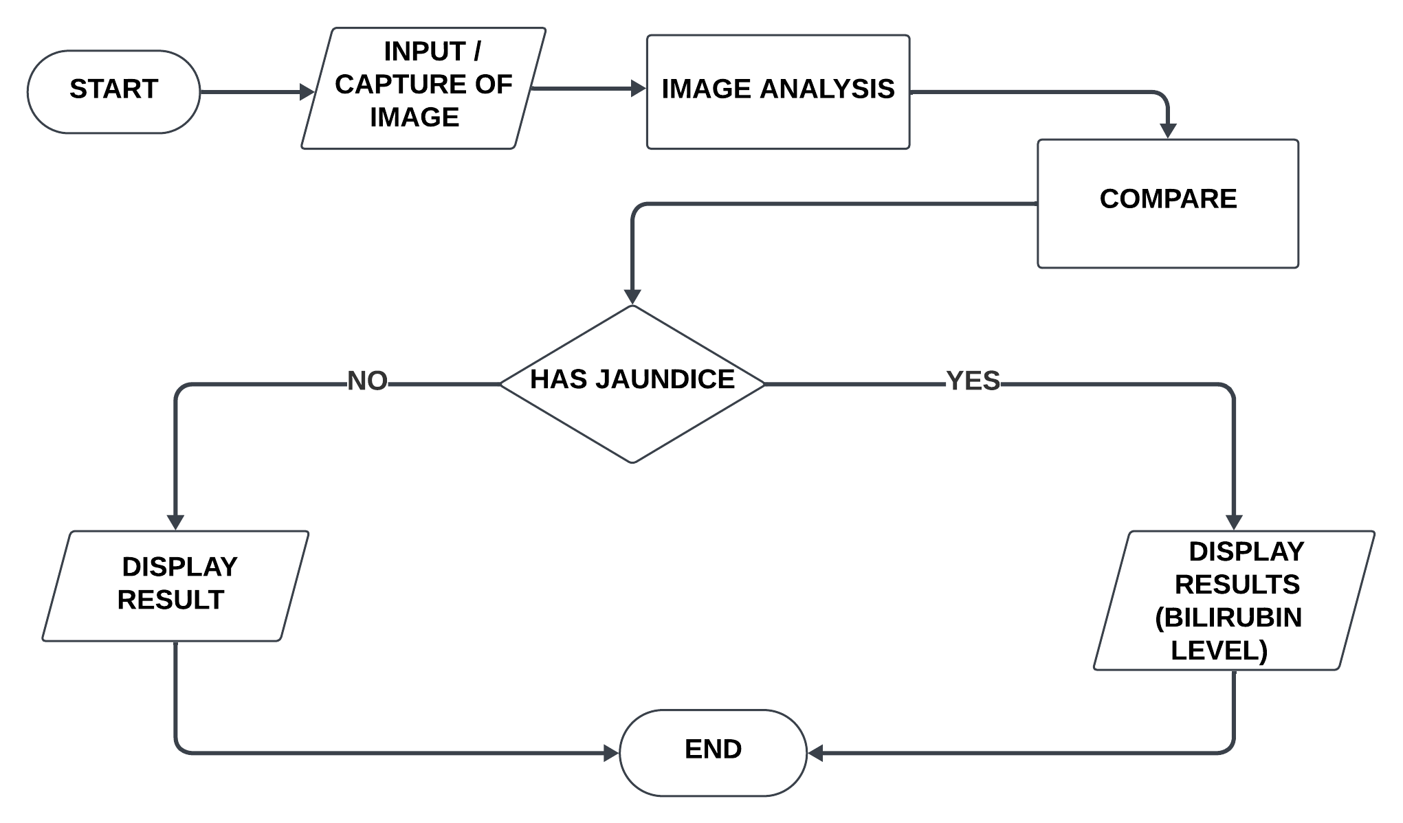
FLOW DIAGRAM

Slide 16
RESOURCE REQUIREMENTS
HARDWARE RESOURCES
Laptop
Smartphone
SOFTWARE RESOURCES
Python
TensorFlow
Android studio
Dart
DATA RESOURCES
Dataset of images of newborns

Slide 17
BUDGET
ITEM | ESTIMATED UNIT PRICE (GH₵) | ESTIMATED QUANTITY
Smartphone | ₵2,000 | 1
Laptop | ******* | *******
Python | ******* | *******
TensorFlow | ******* | *******
Android studio | ******* | *******
Miscellaneous | ₵500
TOTAL | ₵2,500

Slide 18
TASK SCHEDULE
ACTIVITY
NOV DEC JAN FEB MAR APR MAY JUN JUL AUG
Literature Review & Data Collection
Model Development & Training
App Development
Testing & Presentation
Documentation

Slide 19
CONCLUSION
In conclusion, the development of a smartphone app for jaundice detection through AI embodies a remarkable fusion of technology and healthcare, promising a future where early identification of jaundice in newborns is made more accessible, efficient, and potentially life-saving.

Slide 20
REFERENCES
[1] https://physicsworld.com/a/smartphone-app-successfully-detects-jaundice-in- newborn-babies/
[2] Mitra S, Rennie J. Neonatal jaundice: aetiology, diagnosis and treatment. Br J Hosp Med (Lond). 2017 Dec 2.
[3] The smart phone study: assessing the reliability and accuracy of neonatal jaundice measurement using smart phone application. https://www.ijpediatrics.com/index.php/ijcp/article/view/1290
[4] Detection of Neonatal Jaundice by Using an Android OS-Based Smartphone Application, https://brieflands.com/articles/ijp-84397
[5] Neonatal Jaundice Diagnosis Using a Smartphone Camera Based on Eye, Skin, and Fused Features with Transfer Learning
https://www.mdpi.com/1424-8220/21/21/7038

Slide 21
THANK YOU!

